Slide 1

Idea/Approach Details
Problem Statement : Bolstering Transportation Infrastructure: The Challenge of Connecting Geographically Isolated Regions(Region Connectivity) Team Name : Team Simulators

Slide 2
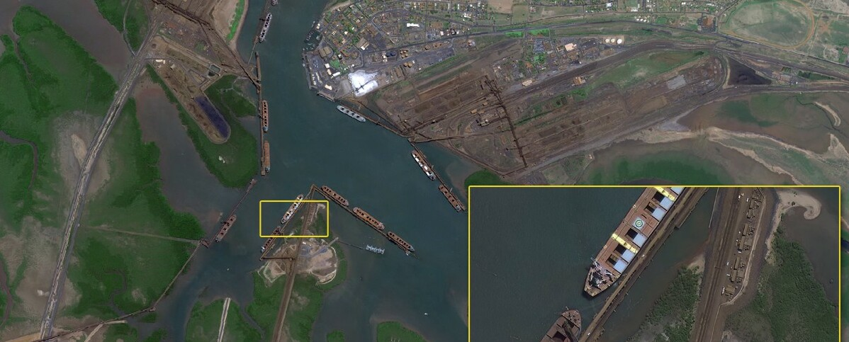



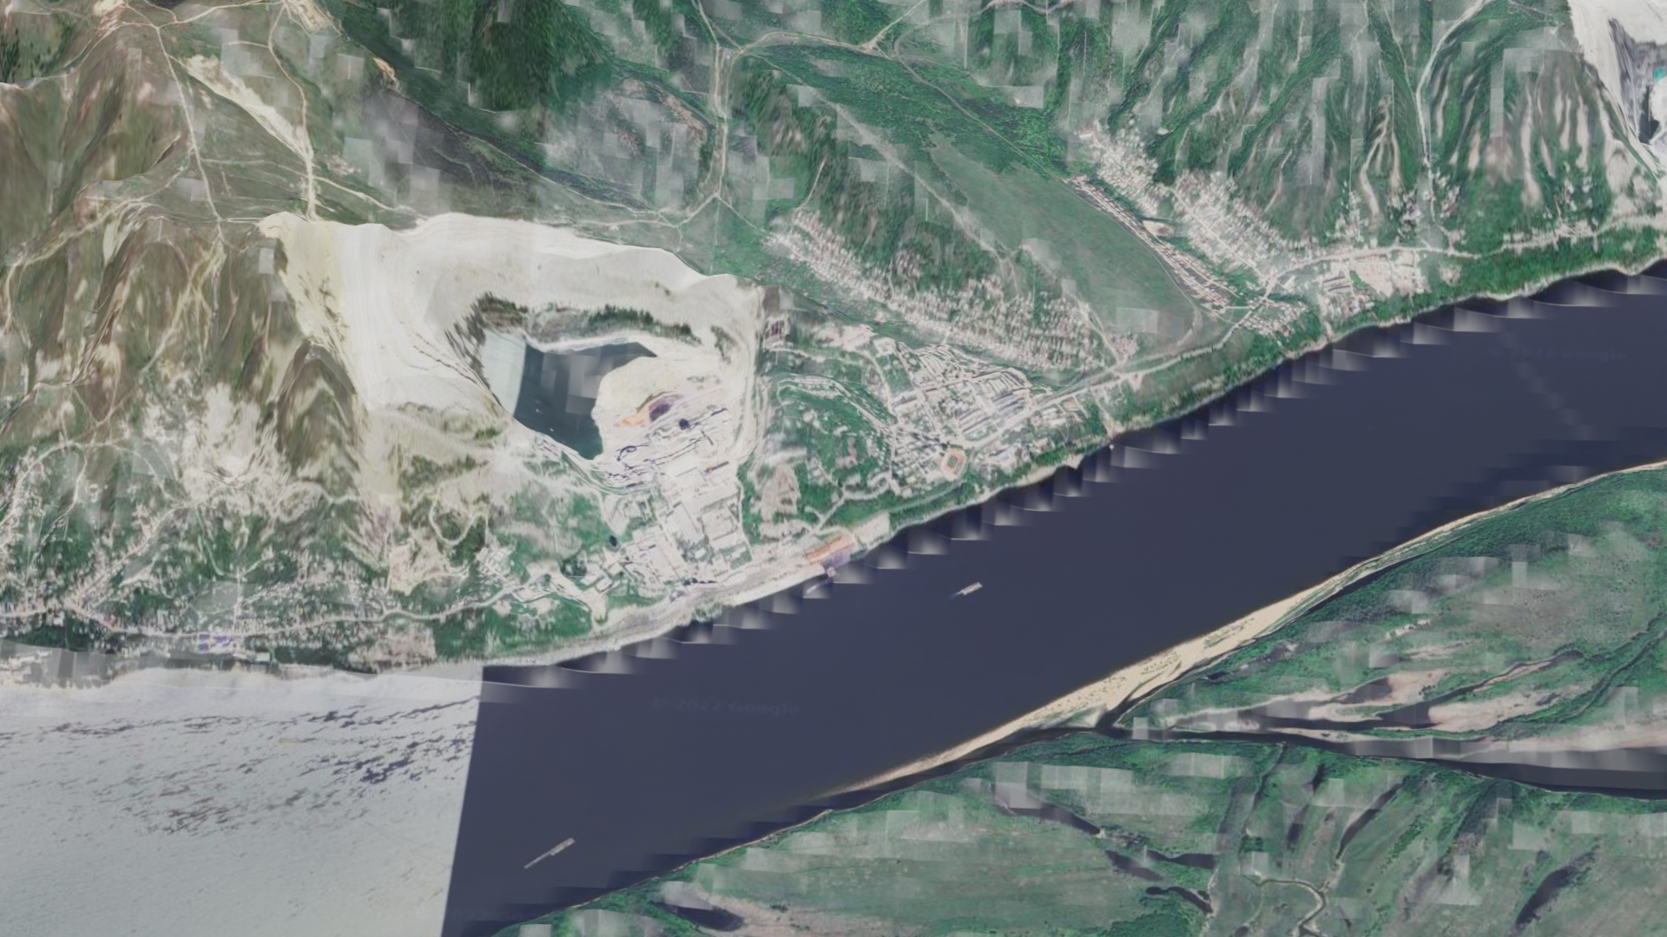


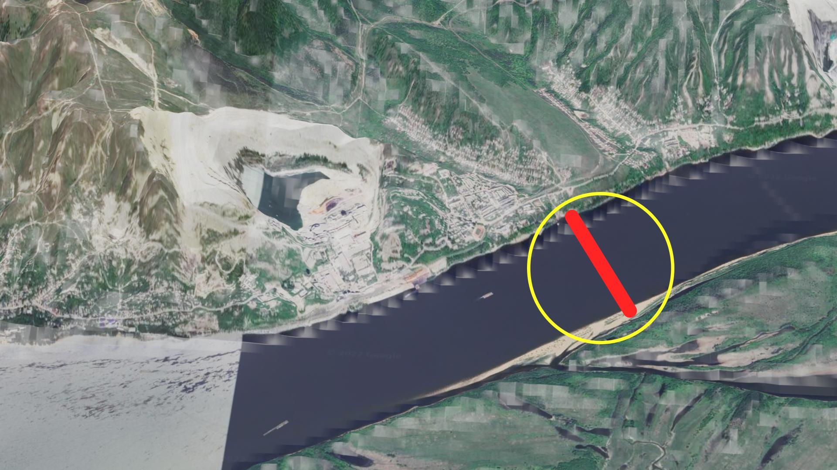
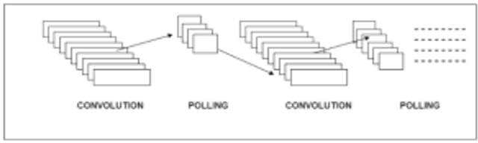
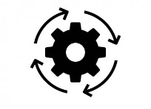

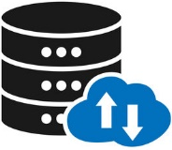
IDEA:
Our design to create a software that suggests connectivity regions across the water sources like rivers or streams in the form of bridges.
The image input will be obtained from a satellite or some kind of aerial vehicle.
With the help of image processing the suggestions will be sent to the respective officials.
TECHNOLOGY STACK:
Satellite image data
Cloud(Database)
Image Processing
Detects connectivity
Image Processing
Using python OpenCV
Official’s
Server
Output
Convolutional neural network
Processing
Image dataset

Slide 3
Convolutional neural network ( recognizing patterns in images)
Satellite image data
(input for processing)
Output
Processing ( Process the data from image dataSet to suggest the connectivity
Cloud(Database that store the input )
Server ( To save the output )
Image Processing ( Scanning the image )
Image dataset ( Has the information of the topography of the land)
Official’s
( Sends the stored output as suggestions )
Image Processing
Detects connectivity
(Identification of connectivity)
Using python OpenCV

Slide 4
Team Members details:
Team Leader Name: Sanjay K
Branch : BE Mechatronics Email: sanjayk5203@gmail.com
Team Member 1 Name: Hrithik J R
Branch : BE Mechatronics Email: herohrithik1950@gmail.com
Team Member 2 Name: Logesh J
Branch : BE Mechatronics Email: logeshraav24@gmail.com
Team Member 3 Name: Deva P
Branch : BE Mechatronics Email: mpdeva2004@gmail.com
Team Member 5 Name: Sriharish J
Branch : BE Mechatronics Email: sriharish.jayakumar@gmail.com
Team Member 4 Name: Muhammad Shahid A R
Branch : BE Mechatronics Email: shahidshaven007@gmail.com
Mentor Name 01: Krishnammal N
Mentor Name 02: Venkatesan R

